Slide 1
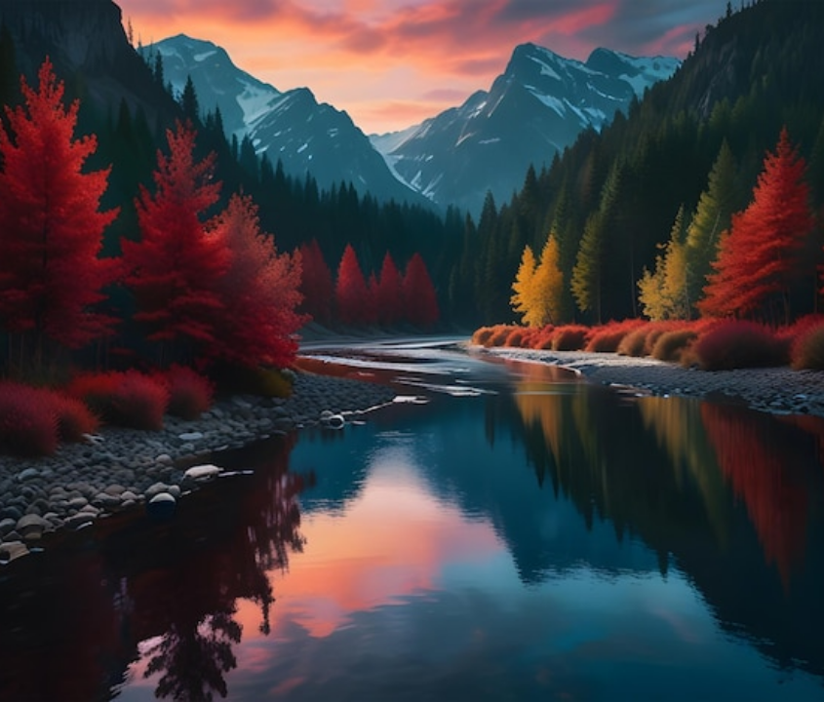

THE
NORDIC
JOURNEY
A PHOTOGRAPHIC EXPLORATION

Slide 2
CHAPTER ONE
The Philosophy
of Slow Travel

Slide 3

Curated Destinations
The High North
The Coastal Fjords
Where the sun barely sets in summer and dances as aurora in winter. A land of stark contrasts and silent beauty, perfect for the solitary traveler seeking introspection.
Ancient valleys carved by glaciers, now filled with the sea. The fjords offer a perspective on time itself, with towering cliffs that have stood watch for millennia.

Slide 4
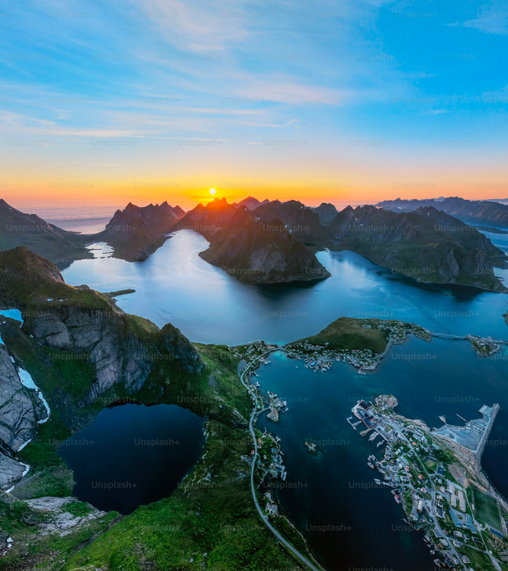
LANDSCAPE FOCUS
Deep Waters
The silence of the fjord is profound. It is not an empty silence, but a full one—filled with the weight of water and stone. Here, the modern world feels very far away.
We explore these waters by electric vessel, ensuring our passage leaves no trace but the wake behind us.

Slide 5
"To move, to breathe, to fly, to float, To gain all while you give, To roam the roads of lands remote, To travel is to live."
HANS CHRISTIAN ANDERSEN

Slide 6
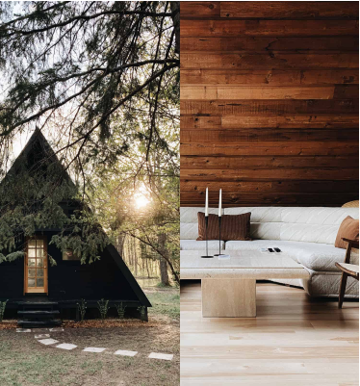
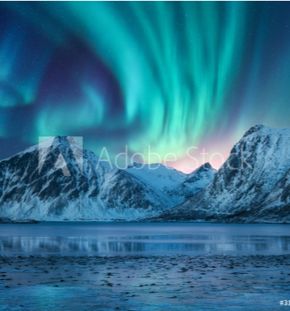
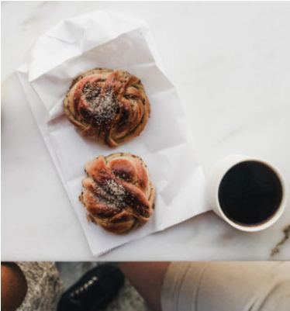
Visual Diary
Hygge
Aurora
Taste

Slide 7
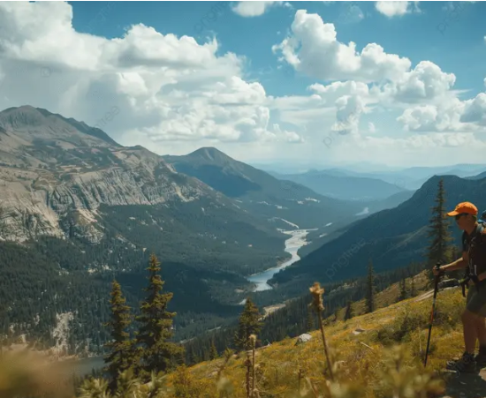
The Art of Hygge
It's more than just a word; it's a feeling of cozy contentment and well-being through enjoying the simple things in life.
Atmosphere: Turn down the lights.
Presence: Turn off the phones.
Comfort: Get comfortable. Take a break.

Slide 8


7-Day Expedition
DAY 1-2
DAY 3-4
DAY 5-6
DAY 7
Oslo Arrival
The Highlands
Fjord Cruise
Bergen Departure
Urban culture & architecture.
Scenic rail journey & hiking.
Electric sailing & kayaking.
Coastal history & farewell.

Slide 9
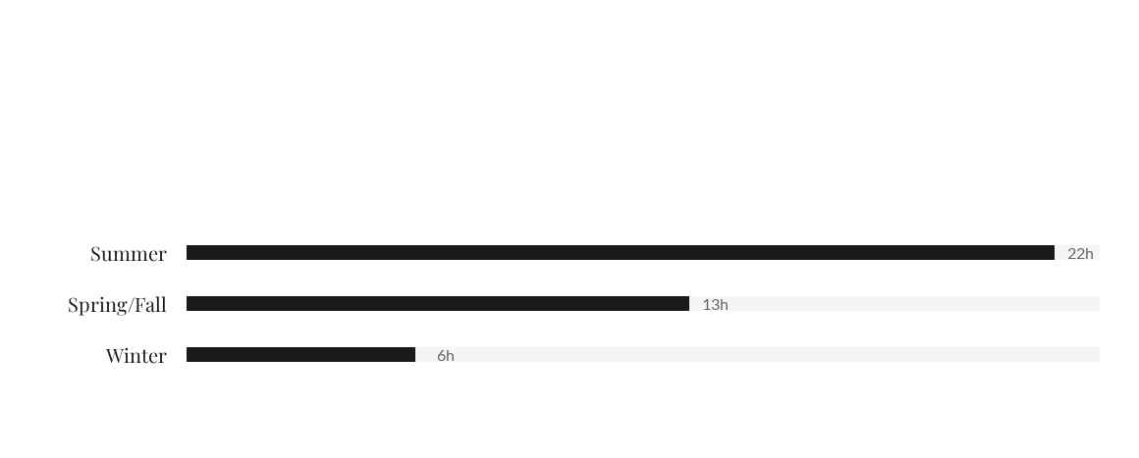
Seasonal Daylight Hours
Planning your trip around light is essential in the North.

Slide 10

Rise of Eco-Tourism
Traveler interest in sustainable, low-impact experiences has doubled.

Slide 11
Exclusive Packages
Package Tier | Duration | Accommodation | Focus
The Explorer | 7 Days | Boutique Hotels | Nature & Hiking
The Heritage | 10 Days | Historic Manors | Culture & History
The Aurora | 5 Days | Glass Igloos | Northern Lights

Slide 12
Inquiries
journey@nordic.com

Slide 13






Image Sources
https://img.freepik.com/premium-photo/forest-beautiful-misty-mountain-cloudy-sky-nordic-natural-scenery-national-park_1164710-982.jpg
Source: www.freepik.com
https://plus.unsplash.com/premium_photo-1756131939059-317cf18526f5?fm=jpg&q=60&w=3000&ixlib=rb-4.1.0&ixid=M3wxMjA3fDB8MHxwaG90by1yZWxhdGVkfDE2fHx8ZW58MHx8fHx8
Source: unsplash.com
https://artfulliving.com/wp-content/uploads/2020/10/LILLA-NORR-FEAT.jpg
Source: artfulliving.com
https://breakthedeal.com/file/2020_09/murale_wall_mural_aurora_borealis_over_the_snowy_mountains_coast_of_the_lake_and_reflection_in_water_northern_lights_above_snow_covered_rocks_winter_l-16yf28x9-1000.jpeg
Source: mamurale.com
https://d2d9hom4y5lr0f.cloudfront.net/2021/01/Swedish-Coffee-FIKA-Culture-Explained-Scandinavia-Standard-624x390.jpg
Source: www.scandinaviastandard.com
https://png.pngtree.com/thumb_back/fw800/background/20250915/pngtree-a-lone-hiker-with-trekking-polish-look-over-vast-scenic-mountain-image_19363152.webp
Source: pngtree.com

